Slide 1
Understanding the Dynamics of Gifted & Siblings
Andrea Gerry MS LMFT

Slide 3
Understanding the Dynamics of Gifted & Siblings
Prevalence of Giftedness within Families
Understanding Birth Order
Sibling Rivalry
Creating opportunities for connection within the Family

Slide 4
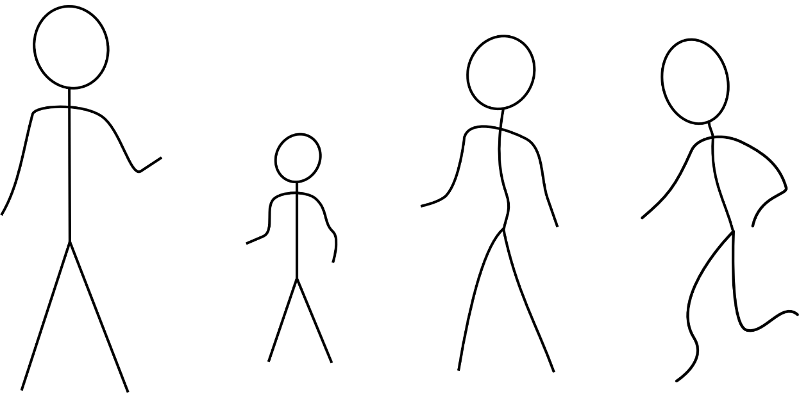
Prevalence of Giftedness within Families

Slide 5
What are the odds…
Brothers and sisters are usually within 5 or 10 points in measured ability.
Parents' IQ scores are often within 10 points of their children's
Even grandparents' IQ scores may be within 10 points of their grandchildren's.
When one child in the family is identified as gifted, the chances are great that all members of the family are gifted.
* Drs. Frank Falk, Nancy Miller & Karen Rogers http://www.gifteddevelopment.com/articles/what-we-have-learned-about-gifted-children

Slide 6
Howard Gardener’s Multiple Intelligences (1983)
Notes:
Linguistic intelligence – This is the ability to use spoken and written language effectively to express yourself. Lawyers, writers, and speakers tend to have high linguistic intelligence.
Logical-mathematical intelligence – This is the ability to analyze problems logically, work effectively with mathematical operations, and investigate issues using the scientific method. Finding patterns and deductive reasoning are other capabilities associated with this intelligence. People working in the scientific and mathematical communities tend to be high in this type of intelligence.
Musical intelligence – This is the ability to perform, compose, and appreciate musical patterns, including changes in pitch, tone, and rhythm. Successful musicians, composers, and people involved in music production have high levels of musical intelligence.
Bodily-kinesthetic intelligence – This is the ability to use the body for expression. People high in this intelligence use their physical coordination to master problems. Professional dancers and athletes are good examples of this.
Spatial intelligence – This is the ability to recognize, use, and interpret images and patterns and to reproduce objects in three dimensions. Successful architects, sculptors and designers are likely to have high spatial intelligence.
Interpersonal intelligence – This is the ability to understand people's intentions, motivations, and desires. This intelligence allows individuals to work well with others. Professions like therapy, teaching, and sales attract individuals with high interpersonal intelligence.
Intrapersonal intelligence – This is the ability to understand yourself, and to interpret and appreciate your own feelings and motivations. Therapists, actors, caregivers, and writers are all people who can bring high levels of personal awareness to their work.
Naturalist intelligence – This is the ability to recognize and appreciate our relationship with the natural world. Astronomers, biologists, and zoologists are examples of professions with a high level of naturalist intelligence. (This is the eighth intelligence that Gardner added, after first publication of his model.)

Slide 7
Emotional Intelligence (EQ)
1990s buzz word
EMOTIONAL INTELLIGENCE (EQ or EI) “Emotional intelligence is the ability to perceive emotions, to access and generate emotions so as to assist thought, to understand emotions and emotional knowledge, and to reflectively regulate emotions so as to promote emotional and intellectual growth.” - John D. Mayer, Peter Salovey, 1997
Daniel Goleman, author of Emotional intelligence
John Gottman, author of Raising an Emotionally Intelligent Child
SOCIAL AND EMOTIONAL LEARNING (SEL)
Often a Curriculum requirement
Self Awareness
Self Regulation
Motivation
Empathy
Social Skills

Slide 8
IQ + EQ = Thriving
IQ
EQ
Linguistic
Intrapersonal
Naturalist
Interpersonal
Logical-mathematical
Musical
Bodily-kinesthetic
Self-awareness
Self-regulation
Motivation
Empathy
Social skills

Slide 9
A Caution on labels
When parents label their children, it limits the child's confidence in other areas.
It is important to parent from a stand point that ALL children are intelligent.
Teach children to “rise to their challenges.”
An
Original

Slide 10
Table Questions
What are the gifts and talents of each of your children?
What is special or unique about each one?
Is one of these talents more valued than the other by your family or society?
Would your child perceive themselves the same way you describe them?

Slide 11
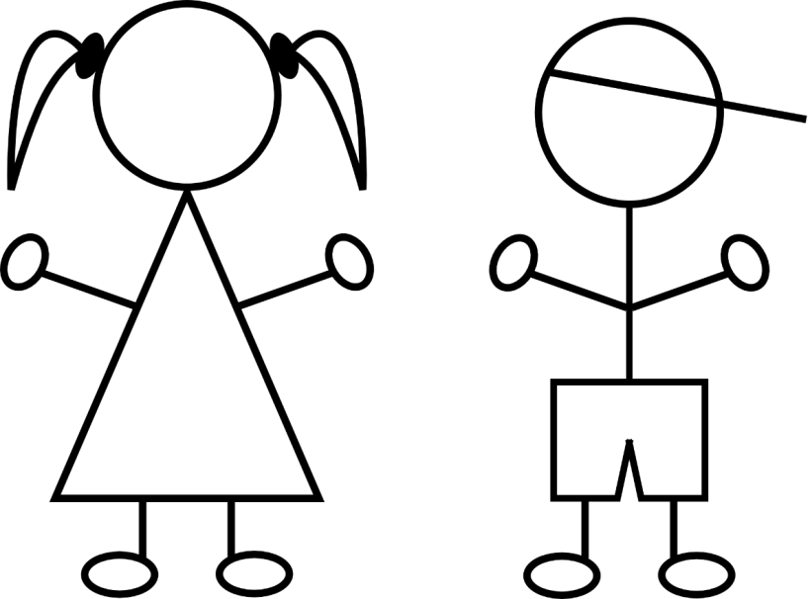
Understanding Birth Order

Slide 12
Birth Order Common Beliefs - Stereotypes
Oldest children – natural leader, ambitious responsible
The middle child – social butterfly, peace keeper, fairness-obsessed
The baby – free spirt, risk taker, charming

Slide 13
First born or Only children…
More likely to be identified as academically gifted
Often characterized as being: serious, dependable, conscientious
Seek adult approval

Slide 14
Middle Children/Second Children
Less likely to be recognized as academically gifted
Often recognized by their excellent interpersonal or leadership skills
Tend to focus more of sibling and peer approval then parent or teacher
Frequently the mediator of the family therefore building the interpersonal and leadership skills

Slide 15
Youngest Children
Lots in common with second children characteristics
If labeled “the baby,” they become dependent on the positive feedback from older siblings and may become fearful of assuming responsibilities or initiating creative activities.
The youngest child may see little likelihood of becoming as competent and successful as older siblings, and besides, it’s much easier to get help from the collection of “big” people around them.

Slide 16
Special Roles
“What do I do well?” “What do I add to this family?”
“The creative one,” “the smart one,” “the clown,” “the social one,” and “the troublemaker”
Special roles can be good as long as they are not limiting (either/or).
Children who are not as SPECIAL at an activity as another should still be encouraged to pursue it.

Slide 17
Caution again on labeling!
When parents label their children, it limits the child's confidence in other areas.
“Jane is the gifted one in the family, so I probably can’t be in the gifted program.”
Loosing your “special role” can lead to underachieving and a even a loss of identity.
An
Original

Slide 18
Table Questions
Was your identified child(ren) the oldest, middle or youngest?
Does that keep in line with Dr. James T. Webb’s citation that “first born (and only) children are more likely to be the ones identified as academically gifted” and “second children are less likely to be identified as gifted, though substantial data suggest that in most cases, their intellectual potential is quite similar to that of their siblings”?

Slide 19
Sibling Rivalry

Slide 20
Does having a identified gifted child who receives attention and recognition for their intellectual and academic accomplishments create harm for another sibling who struggles in school?
Notes:
Consequences of having a gifted sibling: Myths and realities
Researcher Diana Chamrad, Paul Janos, and Nancy M. Robinson conducted a study of over 300 sibling pairs, aged eight to 14, in which neither, one, or both of the children were identified as gifted.
They expected to find that the nongifted siblings were more anxious and depressed, that they were poorer students (relative to their ability), and that they thought less well of themselves and were negatively disposed toward their brother or sister.
To their surprise, all the groups of pairs looked very much the same. In each group there were children whose adjustment and relationships were far from perfect, but where there were differences between the children, it turned out to be an asset to have a gifted brother or sister.
According to their mothers, the children with a gifted sibling had fewer behavioral problems, and in general they were described with more positive adjectives than the children in pairs with no gifted child. Gifted children described their siblings in a friendlier way, and their mothers confirmed their more amicable relationships. We noted not a single unfavorable difference.
The best guess, based on this study, was that having a gifted sibling was simply a ready excuse for the ordinary wear and tear that brothers and sisters inflict on each other.

Slide 21
Consequences of having a gifted sibling: Myths and realities
Researcher Diana Chamrad, Paul Janos, and Nancy M. Robinson conducted a study of over 300 sibling pairs, aged eight to 14, in which neither, one, or both of the children were identified as gifted.
They expected to find that the nongifted siblings were more anxious and depressed, that they were poorer students (relative to their ability), and that they thought less well of themselves and were negatively disposed toward their brother or sister.

Slide 22
Consequences of having a gifted sibling: Myths and realities – cont.
To their surprise, all the groups of pairs looked very much the same. In each group there were children whose adjustment and relationships were far from perfect, but where there were differences between the children, it turned out to be an asset to have a gifted brother or sister.
According to their mothers, the children with a gifted sibling had fewer behavioral problems, and in general they were described with more positive adjectives than the children in pairs with no gifted child.
Gifted children described their siblings in a friendlier way, and their mothers confirmed their more amicable relationships. We noted not a single unfavorable difference.
The best guess, based on this study, was that having a gifted sibling was simply a ready excuse for the ordinary wear and tear that brothers and sisters inflict on each other.

Slide 23
Is all Sibling Rivalry bad?
Struggling with your sibling is natural - Moderation
Holding a different opinion is part of critical thinking
Being assertive enough to argue for that difference will prove to be a valuable skill

Slide 24
How to have a fair row…
Let them “work it out”
Resist the urge to mediate or decide who is at fault
Mediation often increases the rivalry “see, mom’s on my side”
Set limits
Aggressive behaviors
Noise levels
Violation ends in time apart

Slide 25
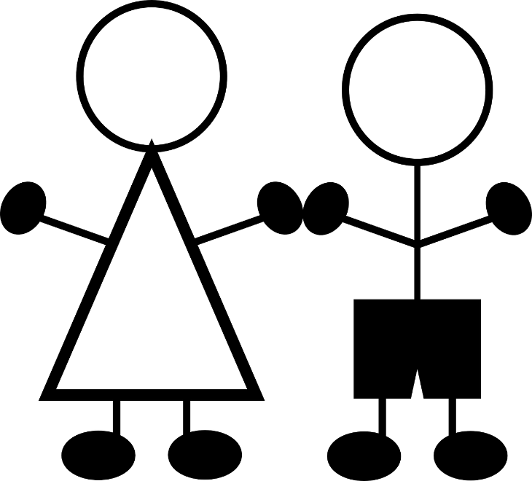
How To “Work It Out”
Listen - Curiosity, Interest, Fascination
Understand – Reflecting what is heard
Validate - Highlights thoughts
Empathize - Recognize feelings
Repeat – till individual calms down

Slide 26
Table Questions
Because you are a parent of a gifted child, do you feel your gifted child(ren) requires or demands extra time and attention?
How do you counter the imbalance of attention among your kids? - Are your children rivals?
Do they compete with each other?
Does your gifted child use their academic advantages to outsmart his/her (identified gifted or not) siblings?

Slide 27
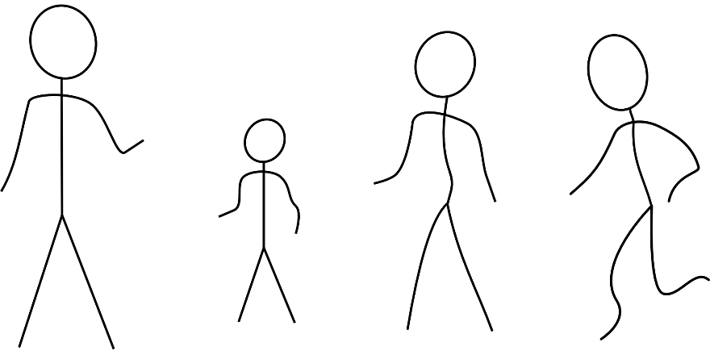
FAMILY Connectedness and Belonging
“Your relationship with your child is more important to (their) long-term future then any educational or enrichment opportunities you could provide, and it will suffer without good interpersonal communication”
- Dr. James T. Webb

Slide 28
Fairness
Fair + equal ≠ identical
Dr. Webb’s Cake story
Diet
Allergy
Don’t like chocolate
Thrilled
What is fair is to give uniquely to each child's individual needs

Slide 29
How To “Work It Out”
Listen - Curiosity, Interest, Fascination
Understand – Reflecting what is heard
Validate - Highlights thoughts
Empathize - Recognize feelings
Repeat – Till individual calms down

Slide 30
Creating Connectedness
Offer special time
One on one time with your child at least a few minutes a day
Set an expectation of a comfortable environment
Stand firm against unacceptable behavior yet avoid being overly critical or punitive
Set goals that include each family members input
Each role is important and valuable

Slide 31
Surprise Planning
The recipe:
One parent gets the children together to plan a surprise for the other parent or for a third child. The children get involved in cooperative planning and feel closer. An alliance with a positive goal builds unity.
The secrets of gift giving, surprises, and parties seem to unite brothers and sisters and diminish arguing. Planning something special for a family member, neighbor, or friend encourages a sense of togetherness that comes from joint efforts.
Parents can effectively use cooperative strategies frequently to build sibling closeness within the family.

Slide 32
Table Questions
What are some examples of goals your family has set to accomplish together? Examples may include serving, planning a vacation, or raising money for playground equipment for the backyard.
Though each child may not have given to the goal equally, how did they use their own talents in achieving this goal?

Slide 33
Resources
BOOKS
Daniel Goleman author of, Emotional intelligence
John Gottman author of, Raising an Emotionally Intelligent Child
Adele Faber and Elaine Mazlish authors of, How to talk so kids will listen & listen so kids will talk
WEBSITES
Inside the mind of a master procrastinator | Tim Urban https://www.youtube.com/watch?v=arj7oStGLkU
BVPAGE
http://www.bvpage.org/

